Slide 1

Green Pace
Security Policy Presentation
Developer: Carmen Mosquera

Slide 2

OVERVIEW: DEFENSE IN DEPTH
This policy was created to strengthen Green Pace’s defense-in-depth strategy and to establish consistent security practices, mitigate vulnerabilities, and safeguard against emerging threats. The policy provides clear guidelines for secure coding, encryption, and access management, supporting the company's mission to deliver secure, high-quality software to its clients.

Slide 3
THREATS MATRIX
Likely STD-001-CPP STD-002-CPP STD-003-CPP STD-004-CPP STD-005-CPP STD-007-CPP | Priority STD-003-CPP STD-004-CPP STD-005-CPP STD-002-CPP STD-007-CPP
Low priority STD-006-CPP STD-009-CPP STD-010-CPP | Unlikely STD-006-CPP STD-008-CPP STD-009-CPP STD-010-CPP

Slide 4
10 PRINCIPLES
PRINCIPLE | STANDARDS
1. Validate Input Data | STD-002-CPP, STD-003-CPP, STD-004-CPP
2. Heed Compiler Warnings | STD-001-CPP, STD-005-CPP, STD-OO8-CPP
3. Architect and Design for Security Policies | STD-007-CPP, STD-009-CPP
4. Keep it Simple | STD-005-CPP, STD-006-CPP, STD-009-CPP
5. Default Deny
6. Adhere to the Principle of Least Privilege
7. Sanitize Data Sent to Other Systems | STD-003-CPP, STD-003-CPP
8. Practice Defense in Depth | STD-005-CPP, STD-010-CPP
9. Use Effective Quality Assurance Techniques | STD-006-CPP, STD-007-CPP
10. Adopt a Secure Coding Standard | STD-001-CPP, STD-002-CPP, STD-003-CPP, STD-004-CPP, STD-005-CPP, STD-008-CPP, STD-010-CPP

Slide 5
CODING STANDARDS
PRIORITY | CODE | STANDARD
High | STD-003-CPP | Guaranteeing sufficient storage for strings is critical for preventing buffer overflows, a common and severe security vulnerability
High | STD-004-CPP | Use parameterized queries and prepared statements to ensure that user input is treated as data, not executable code, by safely escaping potentially dangerous characters and preventing malicious input from altering the structure of the SQL query.
High | STD-005-CPP | Use modern C++ techniques and tools like smart pointers, RAII (Resource Acquisition Is Initialization), and bounds-checking functions to ensure that memory is managed safely and efficiently.
Medium | STD-001-CPP | Use standard C++ primitive types such as int, float, double, char, and bool, instead of their C-style counterparts.
Medium | STD-002-CPP | Use default values when declaring variables: this ensures that variables are initialized properly, preventing undefined behavior and improving code safety.
Medium | STD-006-CPP | User assertion to validate assumptions. This ensures that the code operates under expected conditions by verifying assumptions and invariants.
Medium | STD-007-CPP | Use exceptions for error handling. Exceptions provide a robust mechanism for handling errors in C++ by separating error-handling code from regular code
Medium | STD-008-CPP | Use “enum class” to ensure type-safe and scoped enumerations. This prevents name conflicts and unintended implicit conversions.
Low | STD-009-CPP | Use “struct” and “class” appropriately for user-defined types, this ensures clear and organized code, with “class” for complex behavior and “struct” for simple data structures.
Low | STD-010-CPP | Use “static” for class-level constants to ensure that these constants are shared among all instances of the class.

Slide 6
ENCRYPTION POLICIES
Encryption at Rest
Encryption in Flight
Encryption in Use
Encryption in flight refers to the process of encrypting data as it is transmitted over networks. This ensures that data is protected from interception and tampering during transfer between systems, whether internally or externally.
Encrypting data in flight should be used because it prevents unauthorized users from intercepting or altering the data while it’s being transmitted.
Encryption at rest refers to the process of encrypting data stored on physical media, such as hard drives, SSDs, or backup tapes. This ensures that data remains secure even when it is not actively being used or transmitted.
Encryption at rest should be used because it protects data from unauthorized access in the event of physical theft or unauthorized access to storage systems.
Encryption in use refers to the process of protecting data while it is being processed, such as when it is loaded into memory or being manipulated by an application. This is typically achieved through techniques like secure enclave technologies and homomorphic encryption.
Encryption in use should be used because it protects data during the most vulnerable stages of its lifecycle, where it is typically decrypted for processing. This ensures that even if the system is compromised, the data remains secure.

Slide 7
TRIPLE-A POLICIES
Authentication
Authorization
Accounting
Authentication is the process of verifying the identity of a user or system. It ensures that only legitimate users can access Green Pace’s resources.
Authentication must be implemented for all user logins, including web applications, internal tools, and APIs.
Authentication policies should be used because they are critical in preventing unauthorized access to sensitive data and systems.
Authorization is the process of determining what actions a user is allowed to perform after they have been authenticated.
Authorization must be implemented to control access to various levels of resources based on the user’s role within Green Pace.
Authorization policies should be used because they protect critical resources by ensuring that users can only perform actions for which they have explicit permission.
Accounting involves tracking user activities and system events to provide an audit trail for security and compliance purposes.
Accounting must be implemented across all systems to log user actions, changes to configurations, and access to sensitive resources.
Accounting policies should be used because they are essential for detecting and responding to security incidents and for compliance with regulatory requirements.

Slide 8
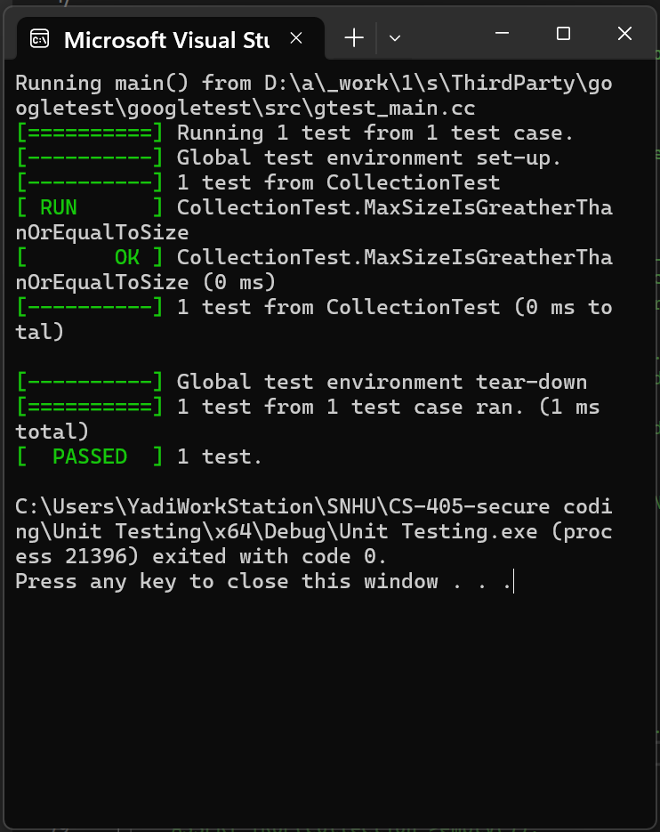
Verify that max size is greater than or equal to size for 0, 1, 5, 10 entries
Unit Testing
TEST_F(CollectionTest, MaxSizeIsGreatherThanOrEqualToSize){
ASSERT_EQ(collection->size(), 0); //check that collection size is zero
EXPECT_GE(collection->max_size(), collection->size());
std::vector<int>entries = { 1, 5, 10 }; //testing for entries 1, 5, 10
for (int entry : entries) {
collection->clear(); //clear collection before adding entries
add_entries(entry); //add entries to the collection
//check that max size is greater than or equal to size
EXPECT_GE(collection->max_size(), collection->size());
}
}

Slide 9
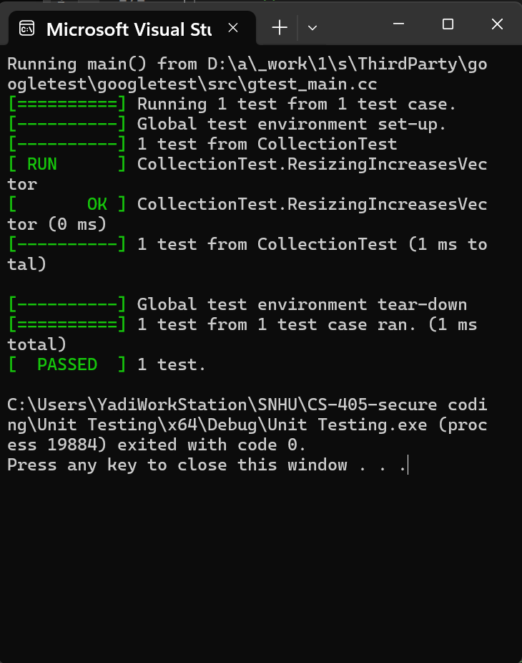
Verify that resizing increases the collection
Unit Testing
TEST_F(CollectionTest, ResizingIncreasesVector){
//check that collection size is zero
ASSERT_EQ(collection->size(), 0);
//resize collection to a bigger size
size_t collNewSize = 13;
collection->resize(collNewSize);
//check that the size has increased
ASSERT_EQ(collection->size(), collNewSize);
}

Slide 10
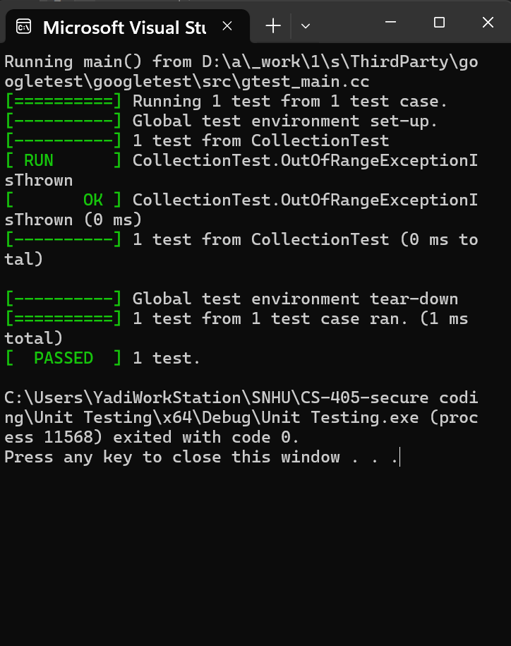
Verify that std::out_of_range exception is thrown when calling at() with an index out of bounds
Unit Testing
TEST_F(CollectionTest, OutOfRangeExceptionIsThrown){
ASSERT_EQ(collection->size(), 0); //check that collection size is zero add_entries(6); //add 6 elements to the collection
ASSERT_EQ(collection->size(), 6); //check that the elements were added
size_t collInitialSize = collection->size();
// If index is out of bound should throw std::out_of_range
//at collection size and at collection size + 1
EXPECT_THROW(collection->at(collInitialSize), std::out_of_range);
EXPECT_THROW(collection->at(collInitialSize + 1), std::out_of_range);
// If index is not out of bound, should not throw
EXPECT_NO_THROW(collection->at(0));
EXPECT_NO_THROW(collection->at(collInitialSize - 1));
}

Slide 11
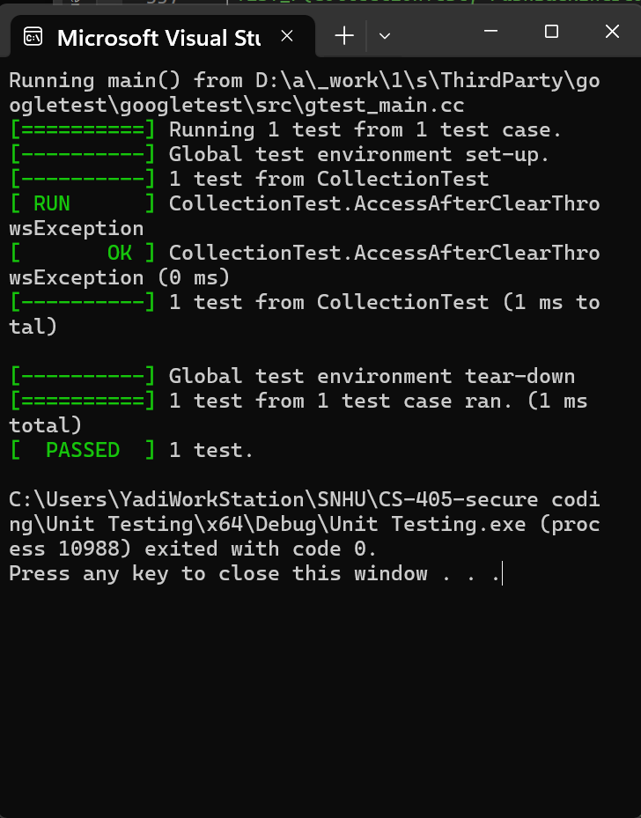
Verify that accessing elements after calling clear results in out-of-bounds access.
Unit Testing
TEST_F(CollectionTest, AccessAfterClearThrowsException){
ASSERT_EQ(collection->size(), 0); //check that collection size is zero add_entries(8); //add 8 elements to the collection
ASSERT_EQ(collection->size(), 8); //check that the elements were added
collection->clear(); //clear the vector
//check that the collection was cleared, size must be zero
ASSERT_EQ(collection->size(), 0);
// Accessing any index should throw std::out_of_range
EXPECT_THROW(collection->at(0), std::out_of_range);
EXPECT_THROW(collection->at(1), std::out_of_range);
}

Slide 12

AUTOMATION SUMMARY

Slide 13
TOOLS
Pre-Production
Production
Assess and Plan: Automation tools can be used to assess the codebase for potential vulnerabilities and ensure that security policies are integrated into the planning phase.
Design: Automation tools can enforce secure coding practices by integrating with design tools and IDEs to suggest security best practices (e.g., OWASP guidelines).
Build: Automation tools can enforce secure coding standards by failing builds that do not meet the defined security criteria.
Verify and Test: Automation tools for vulnerabilities scanning, penetration testing, and static and dynamic application security testing(SAST and DAST) should be integrated in the pipeline.
Transition and Health check: Automated tools should perform final security checks, including configuration checks and penetration testing.
Monitor and Detect: Automated tools for log collection, Security Information and Event Management (SIEM), and Intrusion Detection Systems (IDS) can be used.
Respond: Automated tools should be capable of taking immediate action, such as blocking attacks, rolling back deployments, or disabling services to contain the issue.
Maintain and Stabilize: Automation tools should help assess the system against the security baseline and ensure that it returns to a stable state.

Slide 14
RISKS AND BENEFITS
Problems and Solutions
1. Insecure Data Handling (SQL Injection, Unvalidated Input)
2. Inconsistent Application of Encryption
3. Poor Memory Management (Buffer Overflows, Memory Leaks)
Problem: Vulnerabilities like SQL Injection and unvalidated input can lead to unauthorized access, data breaches, or loss of sensitive information.
Solution: Implement and enforce standards like input validation and the use of parameterized queries.
Risk of Acting Now: Requires immediate resources for code review and refactoring.
Risk of Waiting: Increased risk of a security breach, potential data loss, and higher costs if an issue is exploited.
Problem: Data might not be consistently encrypted across all states (in transit, at rest, in use), leading to potential exposure.
Solution: Enforce encryption policies throughout the data lifecycle.
Risk of Acting Now: Could cause delays in project timelines due to the need for reconfiguration and testing.
Risk of Waiting: Unencrypted data can be intercepted or accessed by unauthorized users, leading to a data breach.
Problem: Insecure memory management can lead to vulnerabilities like buffer overflows, which attackers can exploit.
Solution: Adopt modern memory protection techniques, like smart pointers and bounds-checking.
Risk of Acting Now: Requires immediate code refactoring, which may introduce bugs if not carefully managed.
Risk of Waiting: Ongoing risk of exploitation through memory-related vulnerabilities, potentially leading to system crashes or unauthorized access.

Slide 15
RISKS AND BENEFITS
Acting Now
Waiting
Benefits: Immediate mitigation of critical vulnerabilities, reducing the risk of data breaches and system compromises. Establishing a security-first culture and ensuring compliance with security policies.
Risks: Requires upfront investment in resources, potential delays in project timelines, and the need for thorough testing to ensure stability after changes.
Benefits: Maintains current project timelines and avoids immediate resource allocation.
Risks: Increased likelihood of security incidents, which could lead to higher costs in the long run, reputational damage, and regulatory penalties.

Slide 16
RISKS AND BENEFITS
Strategy Gaps and Risk
Steps to Take
Lack of Comprehensive Testing: If the strategy doesn't include thorough testing after implementing security measures, there's a risk of introducing new vulnerabilities or bugs. Automated security testing tools should be integrated into the DevSecOps pipeline to mitigate this.
Delayed Implementation of Security Standards: Waiting too long to address known issues can lead to them being exploited, making it critical to prioritize high-risk areas like input validation and encryption.
Over-Reliance on Automation: While automation is beneficial, it cannot replace manual code reviews and regular security audits. A balance between automated tools and manual oversight is necessary to ensure comprehensive security coverage.
1. Prioritize Immediate Threats: Address high-risk vulnerabilities first, such as insecure data handling and memory management issues, as these can lead to severe consequences if exploited.
2. Integrate Automated Tools: Ensure that automated detection tools are fully integrated into the DevSecOps pipeline to continuously monitor and enforce compliance with security standards.
3. Continuous Monitoring and Auditing: Regularly review and update the security policies and procedures to adapt to new threats and changes in the technology landscape.
4. Invest in Training: Provide ongoing security training for developers and operations teams to ensure that they are aware of the latest threats and best practices.

Slide 17
RECOMMENDATIONS
1. The current security policy may not fully account for emerging threats like zero-day vulnerabilities or sophisticated phishing attacks, which are increasingly targeting organizations of all sizes.
Example: A notable example is the SolarWinds attack, where sophisticated nation-state actors exploited a supply chain vulnerability to infiltrate multiple organizations. This highlights the need for policies that consider such advanced and evolving threats.
Recommendation: Implement a proactive threat intelligence program to stay ahead of emerging threats. Regularly update the incident response plan and conduct drills to ensure preparedness for various attack scenarios.

Slide 18
RECOMMENDATIONS
2. Relying too heavily on automation without adequate manual oversight can lead to a false sense of security. Automated tools may not catch all vulnerabilities, especially those that require contextual understanding or those that are deeply embedded in complex systems.
Example: The Equifax data breach in 2017, which exposed the personal information of 147 million people, was partly due to a failure to patch a known vulnerability. Despite having automated tools in place, the patch was not applied in time, leading to a massive breach.
Recommendation: Combine automated tools with regular manual code reviews and security audits to catch vulnerabilities that automation might miss. Ensure that human experts are involved in the critical analysis of automated tool outputs.

Slide 19
RECOMMENDATIONS
3. The current policy may not emphasize enough on the need for continuous monitoring and incident response capabilities. Real-time monitoring and a well-defined response plan are essential to detect and mitigate threats before they can cause significant damage.
Example: The Target data breach in 2013, where attackers stole credit card information from millions of customers, could have been mitigated with better monitoring and a more rapid response plan. The attack went unnoticed for weeks, allowing the attackers to exfiltrate vast amounts of data.
Recommendation: Continuously monitor changes in global data protection laws and update security policies accordingly.
Provide regular training to employees on new regulations and their impact on security practices.

Slide 20
CONCLUSIONS
To ensure long-term security and prevent future problems, Green Pace should adopt key standards such as secure coding practices, regular security audits, and comprehensive threat modeling. By training developers in secure coding and making it a core part of the development lifecycle, the company can significantly reduce the risk of introducing vulnerabilities. Regular security audits, both automated and manual, will help identify and remediate security issues early, while threat modeling during the design phase will allow the company to anticipate and defend against new threats.
Additionally, implementing robust data encryption standards, continuous monitoring, and a strong incident response plan will protect sensitive data and mitigate the impact of security incidents. Staying compliant with global data protection regulations and regularly updating security policies will help Green Pace avoid legal penalties and ensure best practices are followed. By fostering a culture of security awareness through continuous training, the organization can equip its team to handle security challenges effectively and build a secure foundation for the future.

Slide 21
REFERENCES
Dunham, R. (2018, July 26). Information Security Policies: Why They Are Important to Your Organization. Linford & Company LLP. https://linfordco.com/blog/information-security-policies/‌
Fruhlinger, J. (2020, February 12). Equifax data breach FAQ: What happened, who was affected, what was the impact? CSO Online. https://www.csoonline.com/article/567833/equifax-data-breach-faq-what-happened-who-was-affected-what-was-the-impact.html
Kassner, M. (2015, February 2). Anatomy of the Target data breach: Missed opportunities and lessons learned. ZDNet. https://www.zdnet.com/article/anatomy-of-the-target-data-breach-missed-opportunities-and-lessons-learned/
Surekha, P., Nandini, P., Shruthi, S., Ankitha, M., Rishitha, P., & Nikitha, P. K. S. (2023). Determining the Security Standards of Different Crypto Algorithms. 2023 International Conference on Sustainable Computing and Data Communication Systems (ICSCDS), Sustainable Computing and Data Communication Systems (ICSCDS), 2023 International Conference On, 1335–1339. https://doi-org.ezproxy.snhu.edu/10.1109/ICSCDS56580.2023.10104653
U.S. Government Accountability Office. (2021, April 22). SolarWinds cyberattack demands significant federal and private-sector response. Www.gao.gov. https://www.gao.gov/blog/solarwinds-cyberattack-demands-significant-federal-and-private-sector-response-infographic
Zeng, M., & Zhu, F. (2021). Secure Coding in Five Steps. Journal of Cybersecurity Education, Research and Practice, 2021(1).

